Slide 1

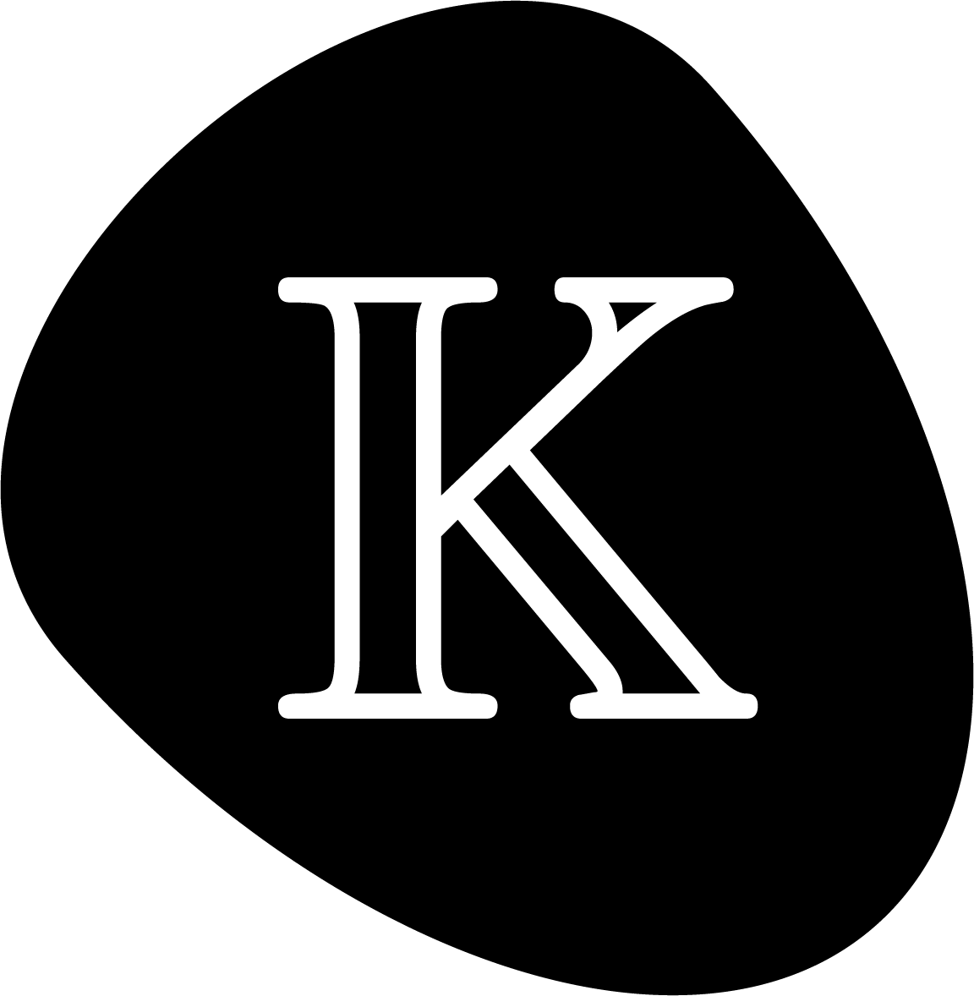
The K Framework
A tool kit for language semantics and verification
PM Session
Smart Contract Verification with kontrol
NAME
21st International Symposium on Automated Technology for Verification and Analysis (ATVA 2023), DATE

Slide 2
PM Session Overview
Quick Intro/Recap to Blockchain, Smart Contract and EVM
Smart Contract Tooling and Testing
Symbolic execution using kontrol
kontrol Hands-on
Github repository for all materials
https://github.com/runtimeverification/k-tutorial-atva-2023

Slide 3
Quick Intro/Recap

Slide 4
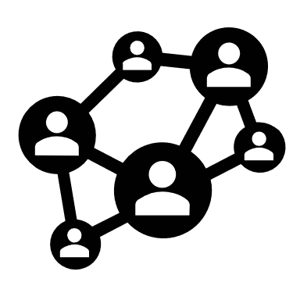

Blockchain
Managed by peer-to-peer network
Which records to be included? Consensus mechanism
Who can propose records?
Permissionless => Anyone
Record
Record
Record
⛓
⛓
⛓
Record
Record
Record
Record
Record
Record
Record
Record
Record
From Wiki: A blockchain is a distributed ledger with growing lists of records (blocks) that are securely linked together via cryptographic hashes.

Slide 5

Blockchain updates VM
Record
Record
Record
Record
Record | Virtual Machine
Transaction | Universal Ledger (e.g., Bitcoin)
Operation from smart contract | Universal Virtual Machine (e.g., Ethereum)
EVM

Slide 6
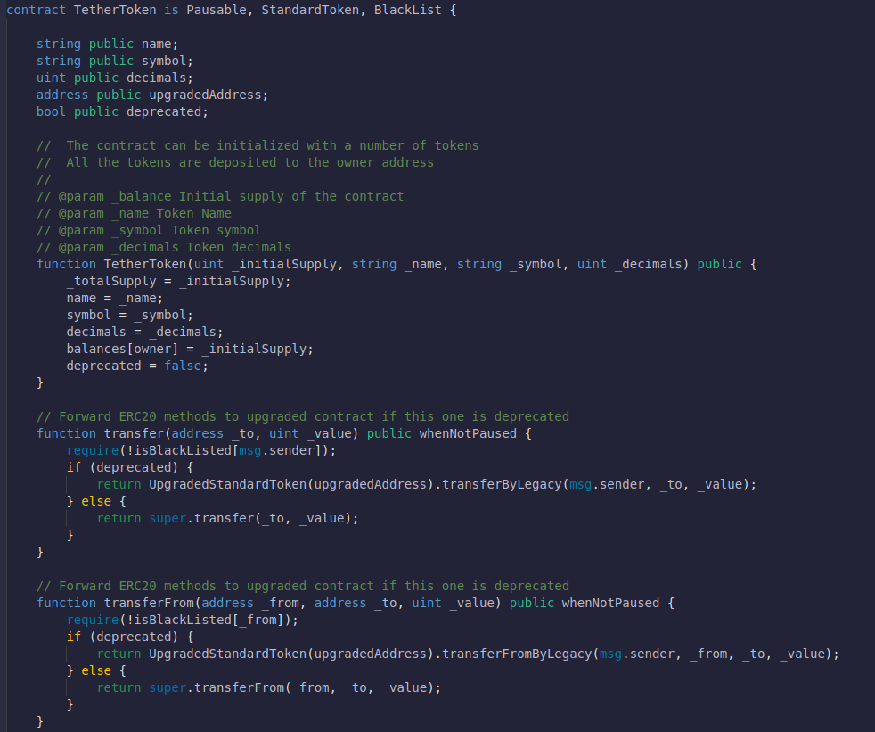
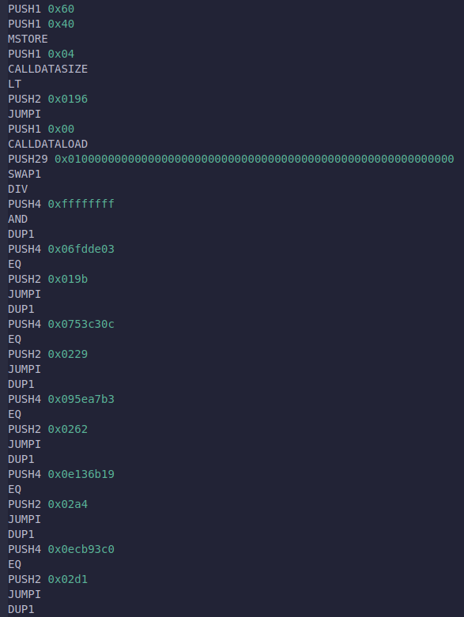
Ethereum Smart Contract
Solidity
Opcode

Slide 7
Permissionless => Issues
Permissionless
Anyone can write a smart contract and deploy it to the network
⚠ Security issues ⚠

Slide 8
Smart contract Tooling and Testing

Slide 9





Property Testing Tools
Unit testing
Fuzz testing
Formal verification
Increase in coverage
Foundry

Slide 10

The Foundry Toolkit
Very easy to use - write property tests and test.
Supports fuzzing over parametric tests at the Solidity level.
Blazing fast execution, providing users with immediate feedback.
There are no false positives¹, but it can produce false negatives².
¹Tests that are supposed to pass will pass.
²Some tests that are supposed to fail may pass because the fuzzing test cannot find counterexamples within the limited number of runs.
Notes:
Foundry is one of the most popular toolkits available for Solidity development.
It is used for compilation, local deployment, dependency management, and much more.
Regarding testing, it allows developers to write parametric tests in Solidity.
This is a significant advantage because developers are familiar with the programming language.
Another step forward is that the parametric tests are executed with randomly assigned values or fuzzed.
This means that Foundry will run your tests with randomly assigned values.
And it will run them very fast.
It can run a test 1000 times, with different inputs, in something like 30 milliseconds.
So it’s a perfect choice for a developer in the building stage who needs immediate feedback.
The feedback is easy to interpret; it provides either a green checkmark, stating that the test is successful, or a red checkmark, stating that it found random values that will break your assertions, providing a counterexample.
But this also comes with a trade-off.
There are no false positives because when a test fails, you get a counterexample that breaks your code, which is good;
But there are false negatives, meaning that the green checkmark does not necessarily mean that your test is correct but that the tool could not find, in the limited amount of runs, a set of values that would break the assertions.
And this may offer a false sense of security.
It does not mean that people should stop using fuzzing.
This is not a comparison between fuzzing and symbolic execution.
The idea is that you can take the best from both worlds by combining them.

Slide 11
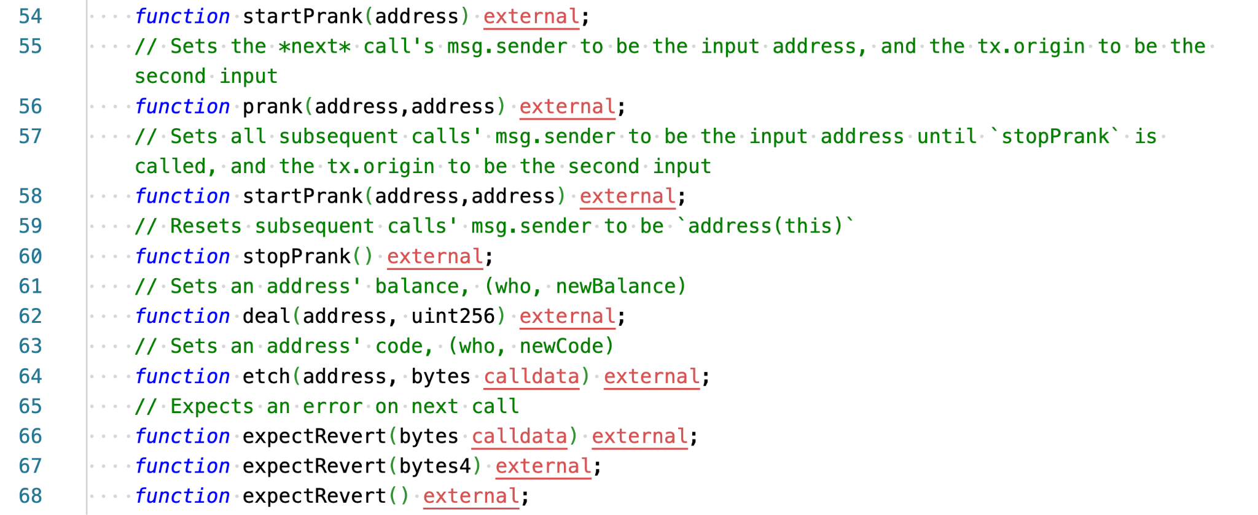
Foundry Cheat codes
A Solidity Interface that contains function signatures
Give developers the ability to alter the state of the EVM from their own Solidity tests

Slide 12
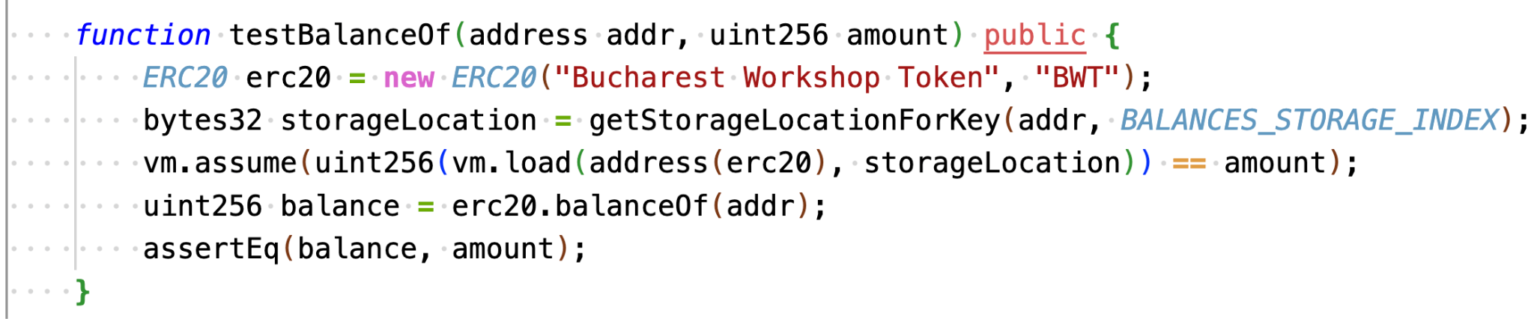
Foundry Fuzz Testing
Foundry would fuzz the values of the function parameters.

Slide 13
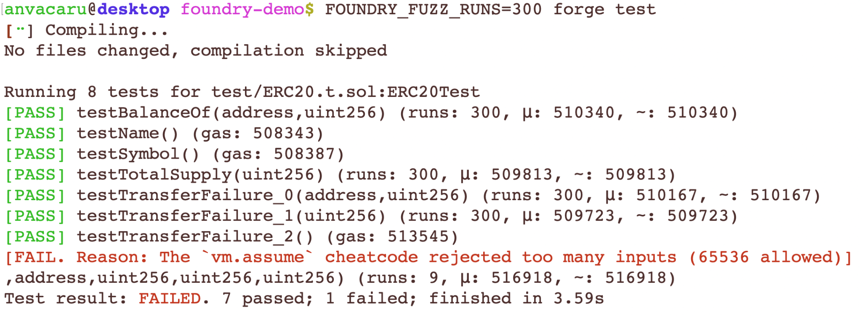
Foundry Fuzz Testing Output
But recall that …
Some tests that are supposed to fail may pass because the fuzzing test cannot find counterexamples within the limited number of runs.

Slide 14
Symbolic execution using kontrol

Slide 15
What is KEVM?
KEVM = Formal semantics of the Ethereum Virtual Machine in K Framework.
Passes same conformance test-suite as other clients.
Enables symbolic execution (and thus verification) of EVM bytecode.
Online: https://jellopaper.org or https://github.com/runtimeverification/evm-semantics
Defined using a configuration and transition rules.
Used by Runtime Verification in formal engagements.
Large-scale proving with K and ACT (from Multi-Collateral Dai system - 1011 proofs)
Notes:
It passes the exact conformance tests the Ethereum foundation provided, like other virtual machine implementations.
This gives us an increased level of confidence in the results of the verification process.
The installation is easier than ever, and docker images are released with each update.
We are using KEVM in formal verification engagements.

Slide 16
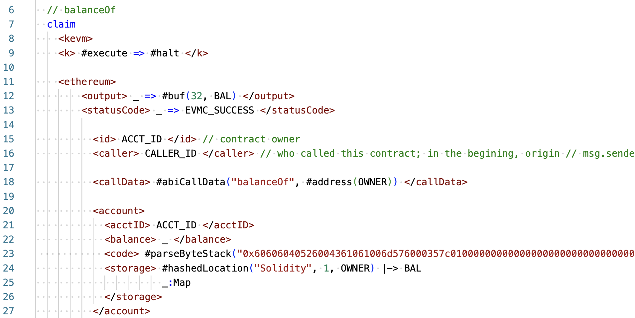
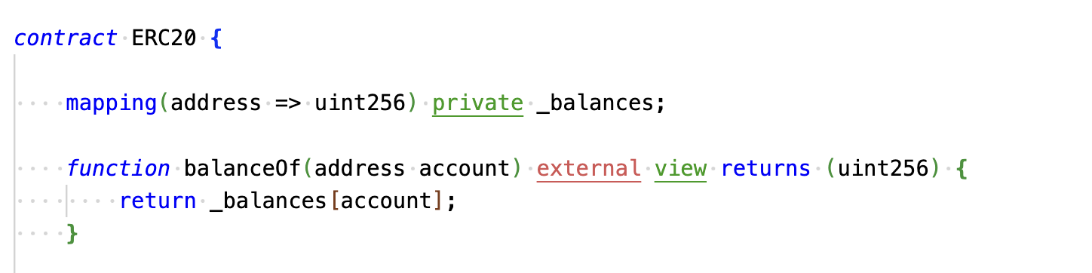
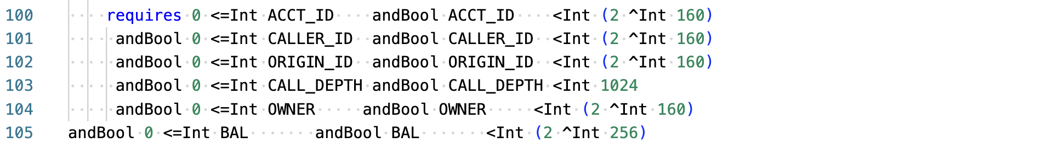
KEVM Former Approach
Provide formal verification BUT difficult to write proofs
Notes:
And here is an example of how we used to write formal verification proofs in the past.
This is a claim or a proof obligation and represents what we are trying to formally verify.
This is for an ERC20 balanceOf function, and I’ll briefly go through it.
A claim is made out of two components, a configuration term and a constraint term
On line 9, we say that the execution starts, and on all paths reached, it will finish.
On line 13, we say that at the end of the transaction, we expect a successful status code, meaning there was no revert or „out-of-gas”.
On line 18, we say that the transaction call data is the „balanceOf” function selector and a symbolic value named OWNER.
So, what this claim says, is for all ACCT_IDS, CALLER_IDS, OWNER_IDS, … when you call ACCT_ID, with this call data, then the transaction finish successfully, and on the output cell, you would have a 32-byte buffer with whatever value is at a specific hashed location where _balances[owner] is stored.

Slide 17
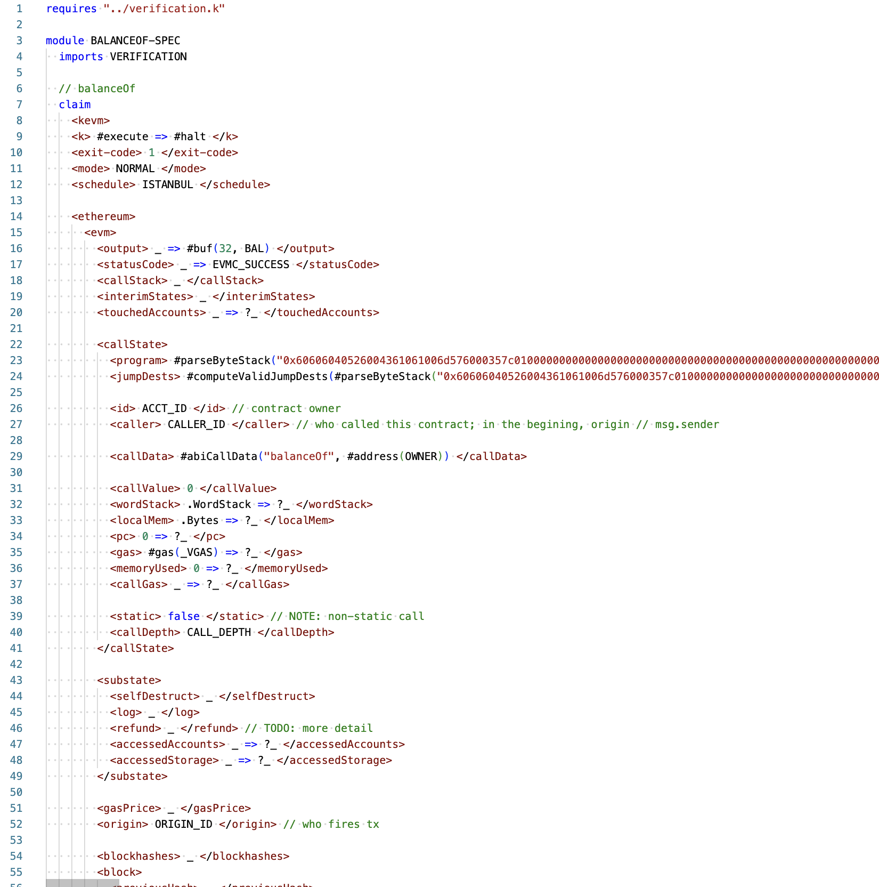
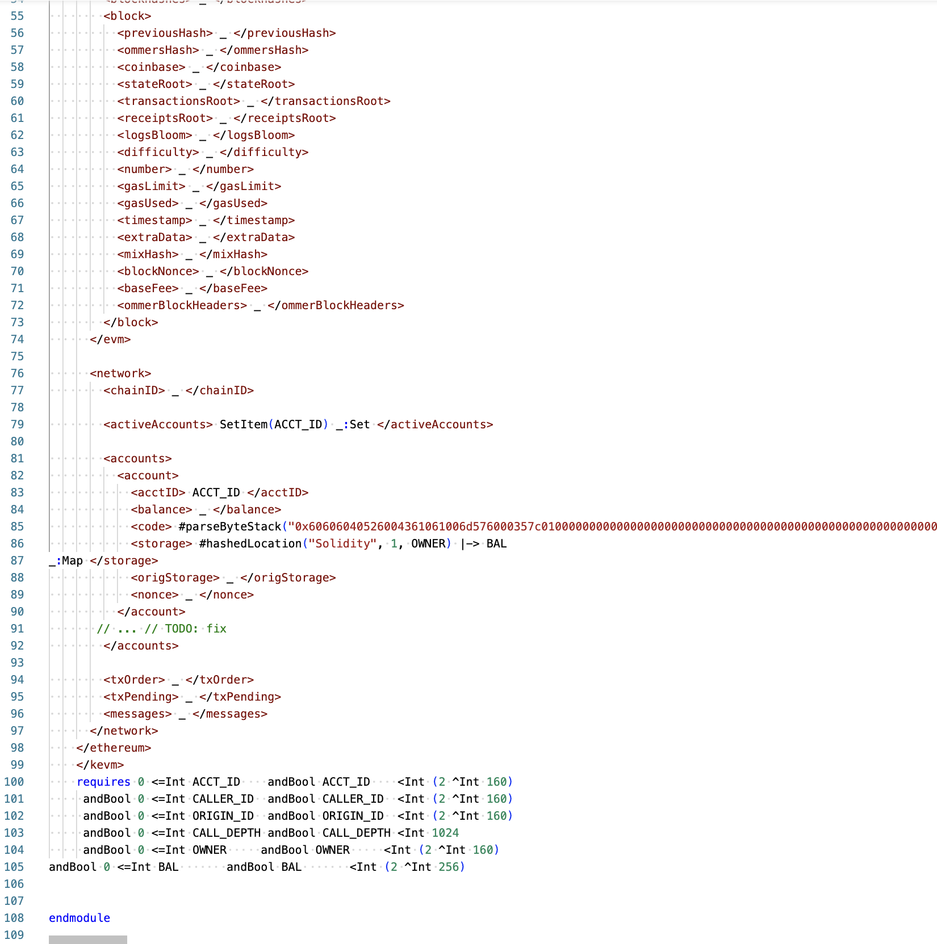
KEVM Former Approach

Slide 18
kontrol
KEVM former approach might be too challenging
Property test function
from Foundry
(Easy to write)
Symbolic execution
of KEVM
(Formal verification)
kontrol

Slide 19
Aiming for Formal Verification
Hoare Triples - (∀ vars){pre-conditions} code {post-conditions}
We can use Foundry and KEVM to define Hoare Triples in Solidity parametric tests.
function testProperty(vars) external {
assume pre;
code;
assert post;
}
Using the symbolic execution capabilities of KEVM, it will formally verify the specifications.

Slide 20
kontrol Hands-on

Slide 21
Step-by-step tutorial
Github repository for all materials
https://github.com/runtimeverification/k-tutorial-atva-2023

Slide 22
More on kontrol
Find out more at
https://docs.runtimeverification.com/kontrol/overview/readme

Slide 23





Questions?
https://runtimeverification.com/
@rv_inc
https://discord.com/invite/CurfmXNtbN
contact@runtimeverification.com

